Slide 1
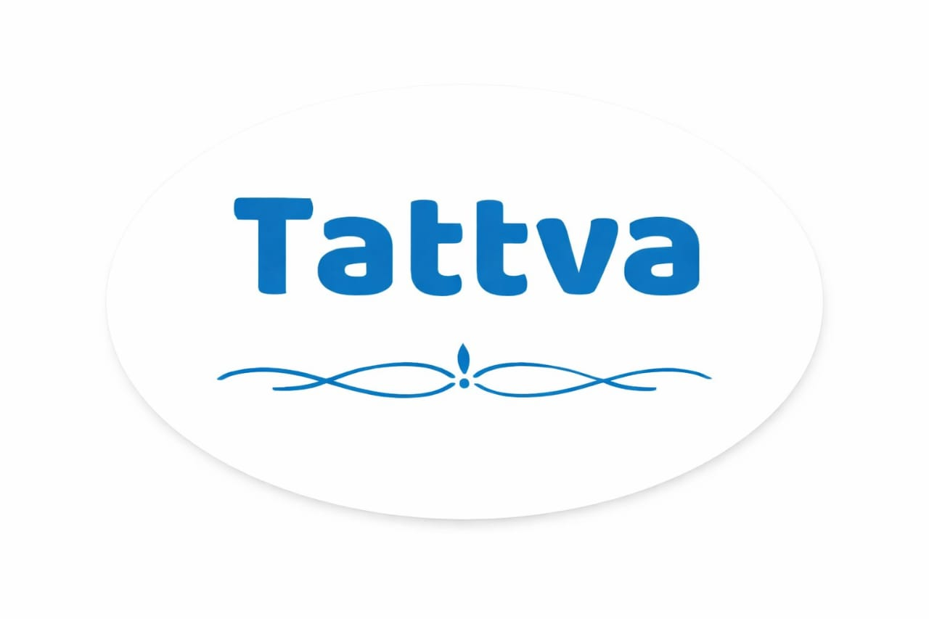
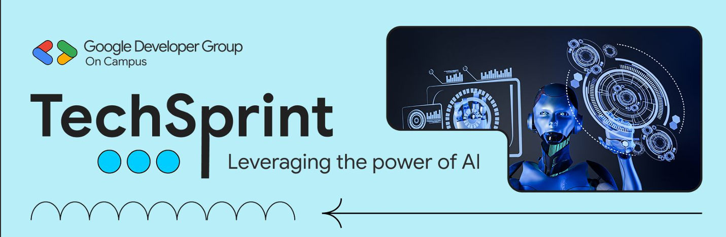
Team Details :
Team name: TATTVA
Team leader name: T. Nagajyothi
Problem Statement: Generative AI can create highly realistic fake videos, images, and audio that are almost impossible for humans to detect.

Slide 2
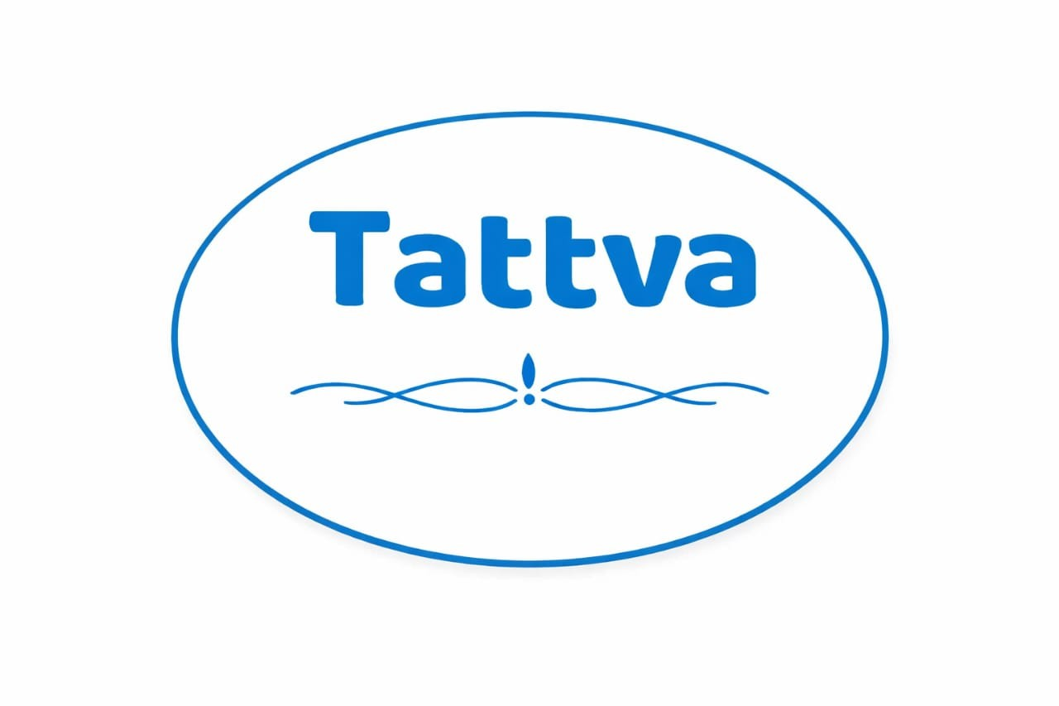

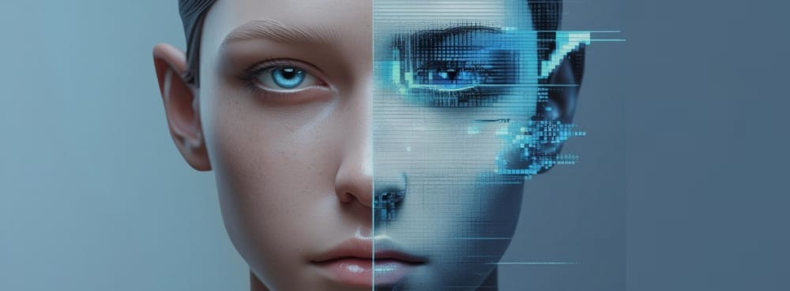
TATTVA is an AI-powered web platform that detects deepfake images, videos, and audio instantly. It analyzes uploaded media and provides real/fake results with confidence scores, helping restore digital trust.
Proposed Solution

Slide 3
Opportunities:
How is it different from existing ideas?
• Supports image, video, and audio in one platform
• Provides real-time detection instead of delayed analysis
• User-friendly interface suitable for non-technical users
How does it solve the problem?
• Uses ML models to analyze media authenticity
• Gives instant, clear results
• Reduces spread of misinformation before it goes viral

Slide 4
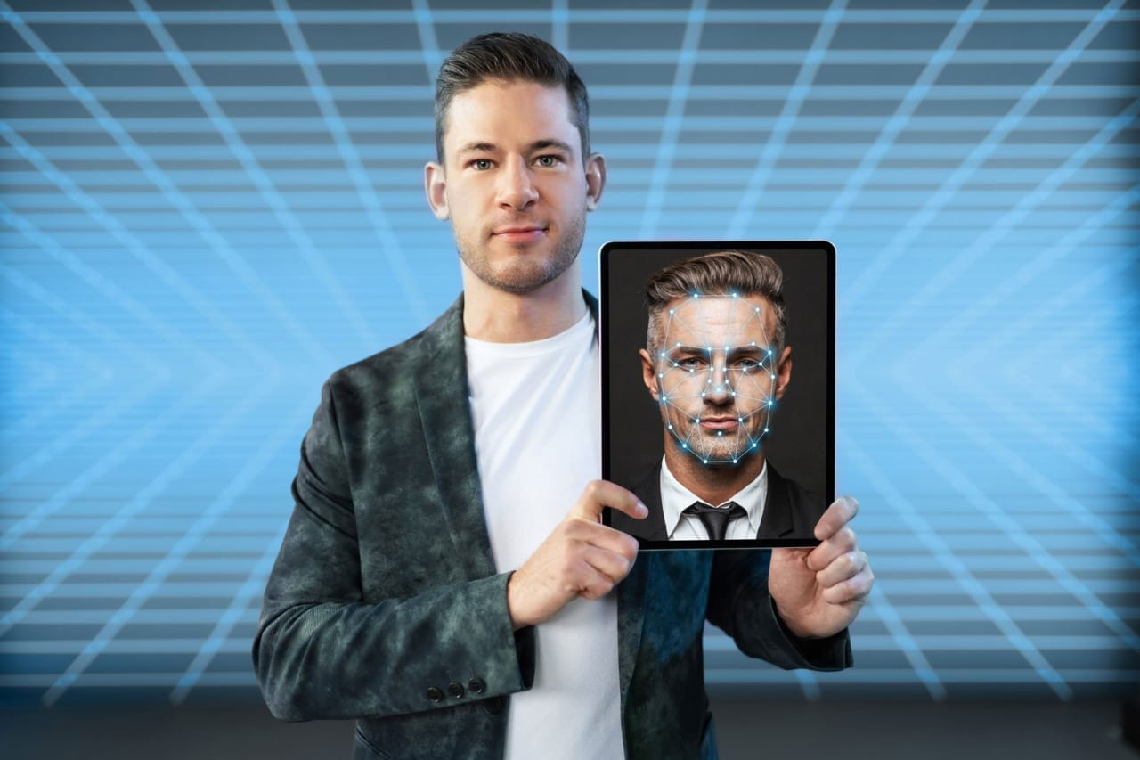
• Upload image, video, or audio files
• AI-based deepfake detection
• Real/Fake classification
• Confidence score for authenticity
• Clean and responsive web interface
• Secure file handling
Features Offered

Slide 5





Google Technologies Used
• Google Colab – Model training and testing
• Google Drive – Dataset and model storage
• Google Firebase (optional) – Hosting & authentication
• Google Cloud (GCP) – Scalable deployment
• TensorFlow – Deep learning framework
Colab
Drive
Cloud
TensorFlow

Slide 6
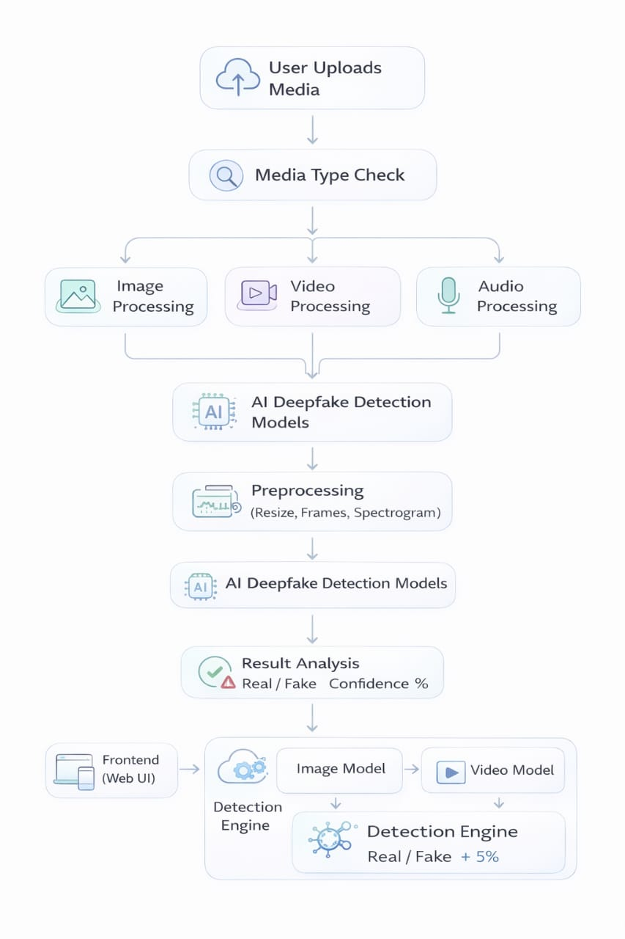
Process Flow Diagram

Slide 7
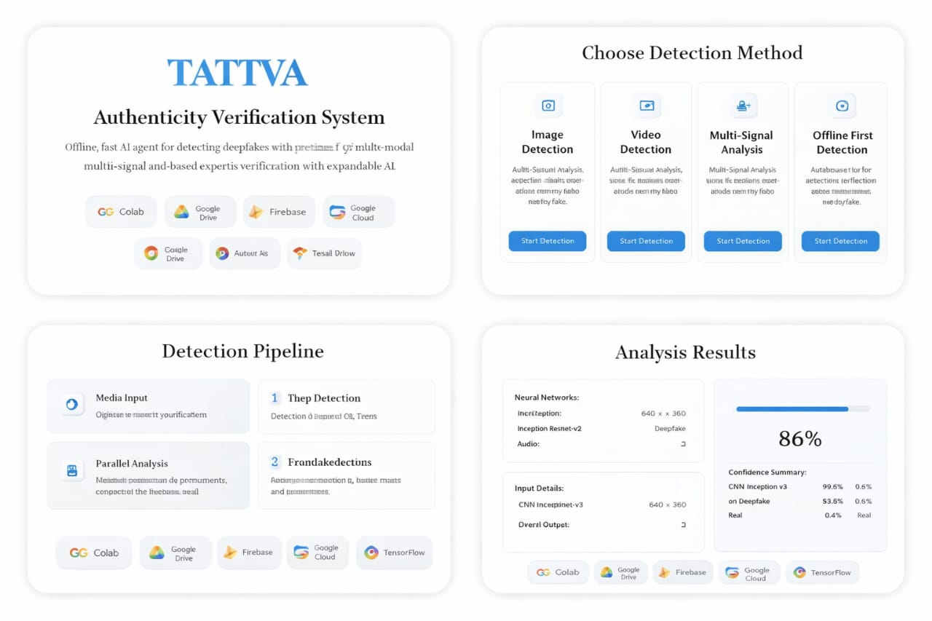
Snapshots of the MVP

Slide 8
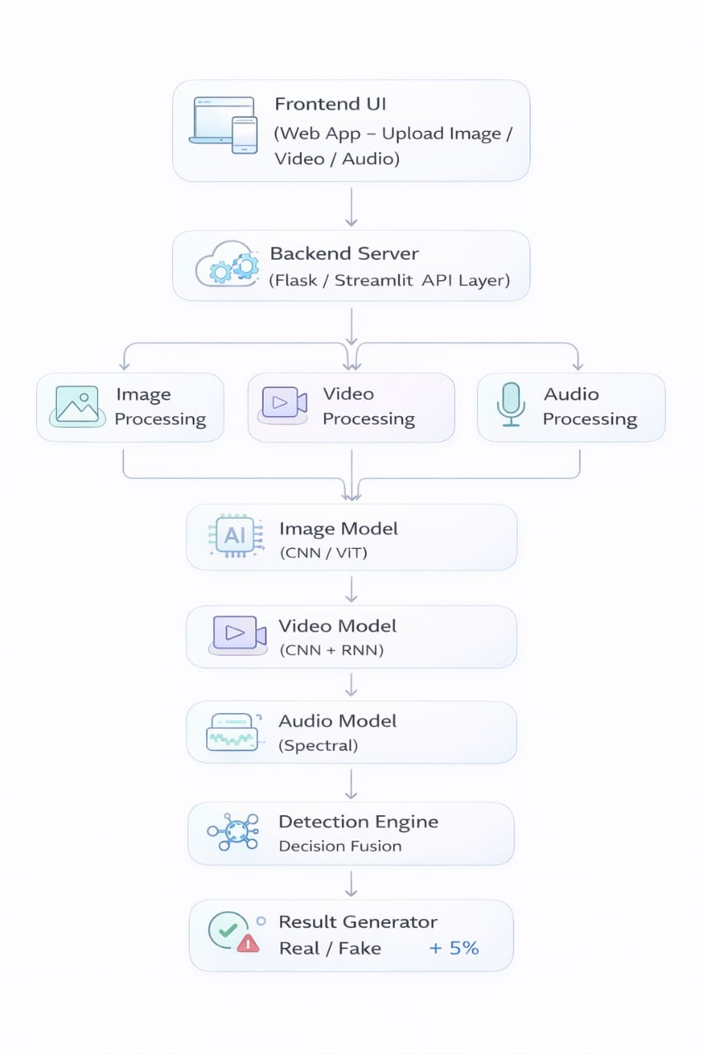
Architecture Diagram

Slide 9
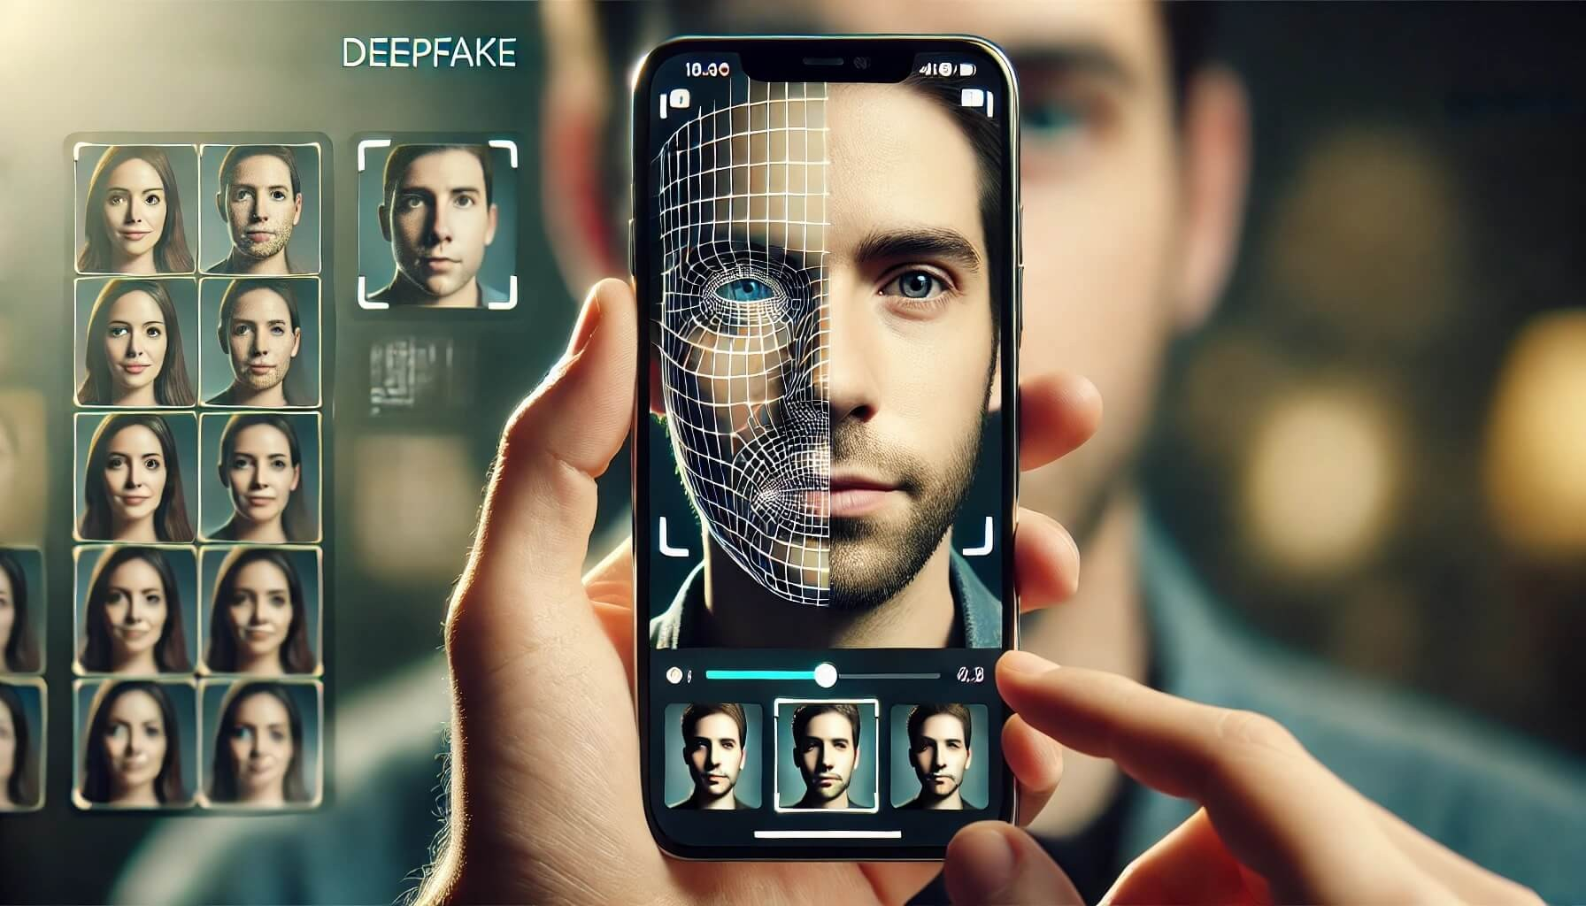
• Real-time video stream detection
• Browser extension for social media verification
• Mobile application support
• Advanced explainable AI reports
• Integration with law enforcement and media platforms
Additional Details / Future Development

